Slide 1

RNA-Seq

Slide 2


TRREP: TRANSCRIPTÓMICA, REGULACIÓN GENÓMICA Y EPIGENÓMICA
Calificación = 0.4*Trabajo + 0.5*Examen teórico+0.1*participación

Slide 3
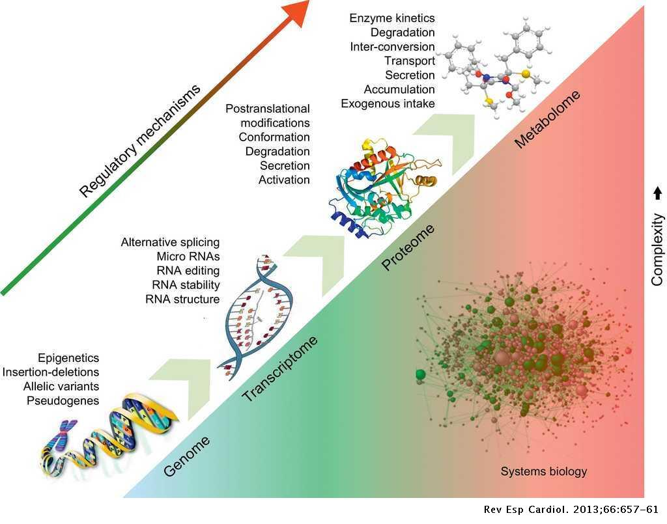

Slide 4
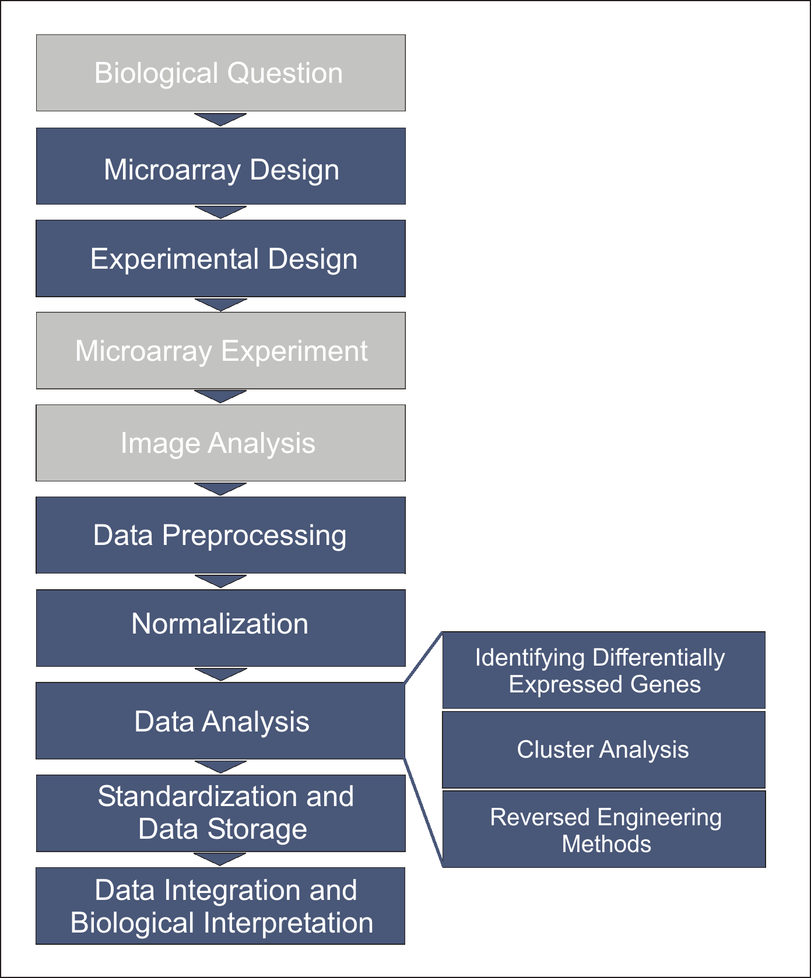
omics experiment pipeline
Platform definition
Experiment
Analysis of DNA microarray data. Hackl H, Sanchez Cabo F, Sturn A, Wolkenhauer O, Trajanoski Z. Curr Top Med Chem. 2004;4(13):1357-70. doi:10.2174/1568026043387773.

Slide 5
Previously in TRREP…
Experimental design in omics experiments
Replication:
Understand the difference between biological and technical replicates and its impact in estimates
What is pooling and when to use it
Why is three the magical number (in animal experiments)
Randomization
Blocking
Ways to control confounders
Batch effect
Statistical peculiarities of omics data for quantification of expression:
Small sample size leads to a bad estimation of the variance per gene
Moderated t-tests “borrow” information from all genes to improve per-gene variability estimates
Large number of hypothesis tested simultaneously:
Need to correct the p-values…best using the FDR (probability to make X% errors from the total of detected trues)
Data is not normal
Large variability for poorly expressed genes -> variance estabilization normalization
Normalization per library size and gene length

Slide 6
NGS/ARRAYS

Slide 7
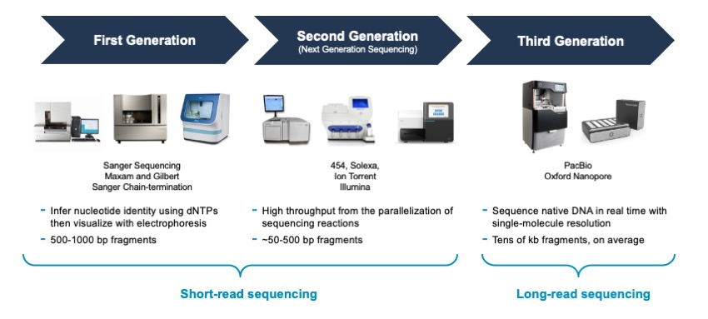
Next Generation sequencing (Ngs)
2000-2010
>2010
>2015

Slide 8
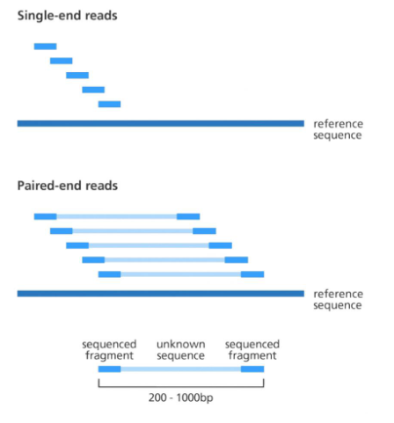
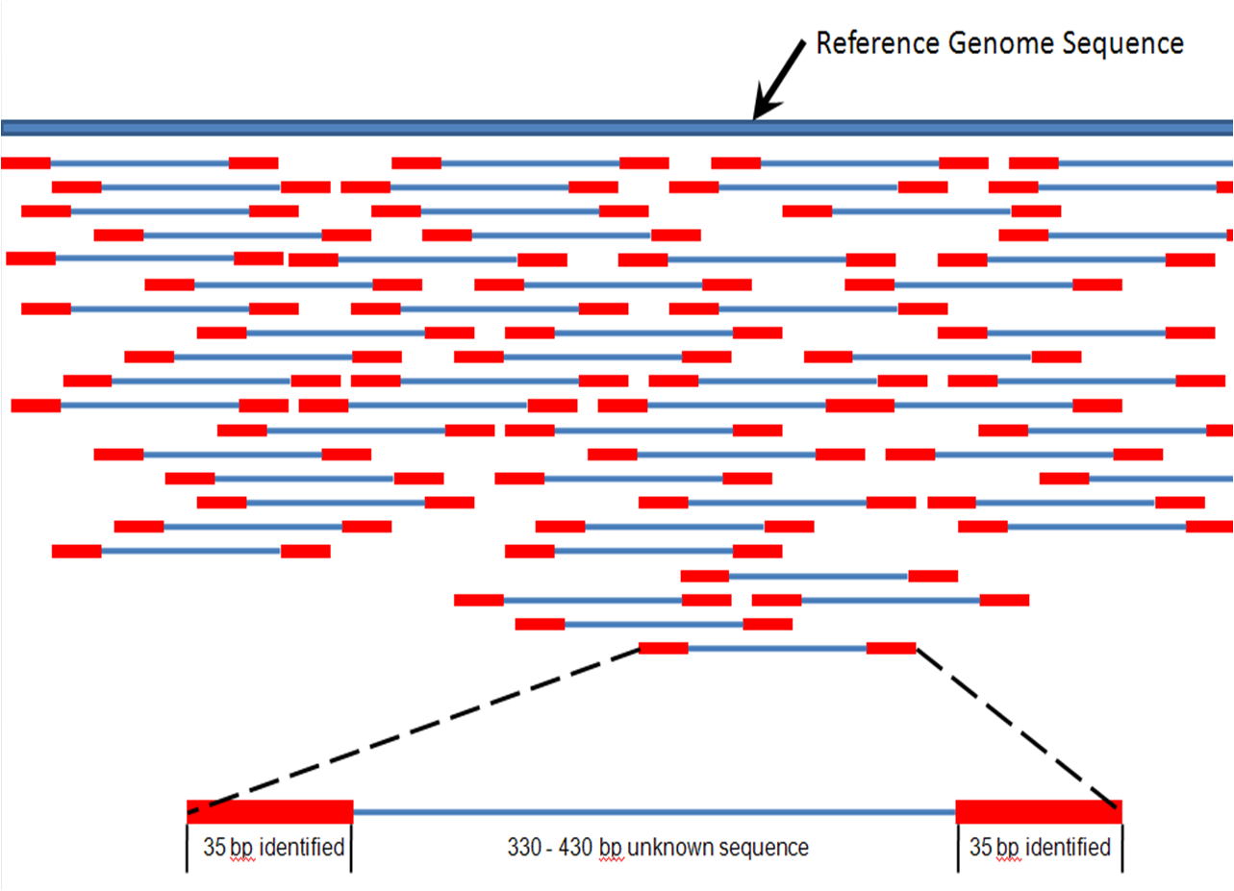
READS

Slide 9
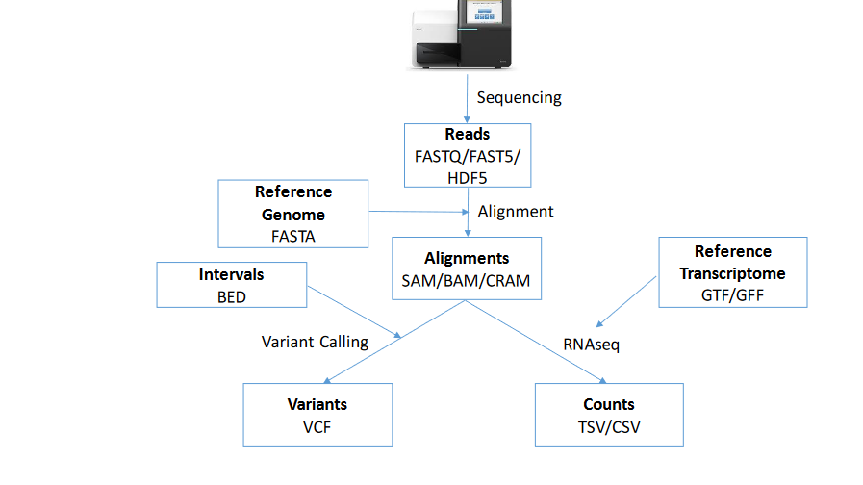

Slide 10
NGS Analysis WorkFlow
Initial QC
Pre-processing and Post-QC
Feature Reference
Alignment
Detection
Counting
Statistical Analysis

Slide 11
Sequencing Result: FASTQ Format
A file with Millions of reads
FASTQ file format: Millions of 4 line records
Record format:
Line 2: Sequence
Line 1: @ + Identifier
@SEQ_ID
GATTTGGGGTTCAAAGCAGTATCGATCAAATAGTAAATCCATTTGTTCAACTCACAGTTT
+ SEQ_ID
!''*((((***+))%%%++)(%%%%).1***-+*''))**55CCF>>>>>>CCCCCCC65
Line 3: “+” + Identifier (optional)
Line 4: Phred based Quality Score

Slide 12
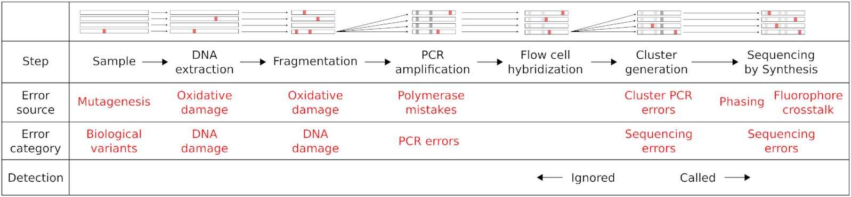
Sequencing steps in which polimorphisms might arise

Slide 13
FASTQ Format
The Phred Quality Score
Phred quality scores Q are defined as a property which is logarithmically related to the base-calling error probabilities P
Q = -10 log₁₀ P
Q | P | Base call accuracy
10 | 1 in 10 | 90%
20 | 1 in 100 | 99%
30 | 1 in 1000 | 99.9%
40 | 1 in 10000 | 99.99%
50 | 1 in 100000 | 99.999%
P = 10^{-Q/10}

Slide 14
FASTQ Format
The Phred Quality Score
The Quality Score is encoded as a letter using the Decimal ASCII code for the asignment
SSSSSSSSSSSSSSSSSSSSSSSSSSSSSSSSSSSSSSSSS.....................................................
..........................XXXXXXXXXXXXXXXXXXXXXXXXXXXXXXXXXXXXXXXXXXXXXX......................
...............................IIIIIIIIIIIIIIIIIIIIIIIIIIIIIIIIIIIIIIIII......................
.................................JJJJJJJJJJJJJJJJJJJJJJJJJJJJJJJJJJJJJJJ......................
..KKKKKKKKKKKKKKKKKKKKKKKKKKKKKKKKKKKKKKKK....................................................
..LLLLLLLLLLLLLLLLLLLLLLLLLLLLLLLLLLLLLLL.....................................................
!"#$%&'()*+,-./0123456789:;<=>?@ABCDEFGHIJKLMNOPQRSTUVWXYZ[\]^_`abcdefghijklmnopqrstuvwxyz{|}~
| | | | | |
33 59 64 73 104 126
0........................26...31.......40
..........................5....0........9.............................40
...............................0........9.............................40
..................................3.....9.............................40
0.2......................26...31........41
0.2......................26...31.......40
S - Sanger Phred+33, raw reads typically (0, 40)
X - Solexa Solexa+64, raw reads typically (-5, 40)
I - Illumina 1.3+ Phred+64, raw reads typically (0, 40)
J - Illumina 1.5+ Phred+64, raw reads typically (3, 40) with 2=Read Segment Quality Control Indicator (bold)
K - Illumina 1.8+ Phred+33, raw reads typically (0, 41)
L - Illumina 1.9+ Phred+33, raw reads typically (3, 40)
with 0=unused, 1=unused, 2=Read Segment Quality Control Indicator (bold)
ASCII code
Phred score

Slide 15
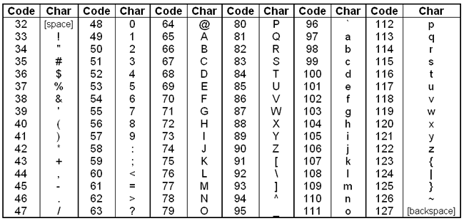
Decimal ASCII Code

Slide 16
NGS ANAlysis workflow
Initial QC
Pre-processing and Post-QC
Feature Reference
Alignment
Detection
Counting
Farther Statistical Analysis

Slide 17
QC Raw Reads
Goals:
Detect sequencing problems
Detect adaptors
Compare Libraries for posterior analysis

Slide 18
QC Raw Reads
Questions to have in mind when assessing the quality of the experiment and sequencing
How is the experiment design?
Which are the DNA/RNA features I want to interrogate?
How were this features enriched in our samples?
Which kind of library has been done?
Different experiments require different interpretation of the QC analysis.
Tools used:
FastQC: For evaluating quality of experiment.

Slide 19
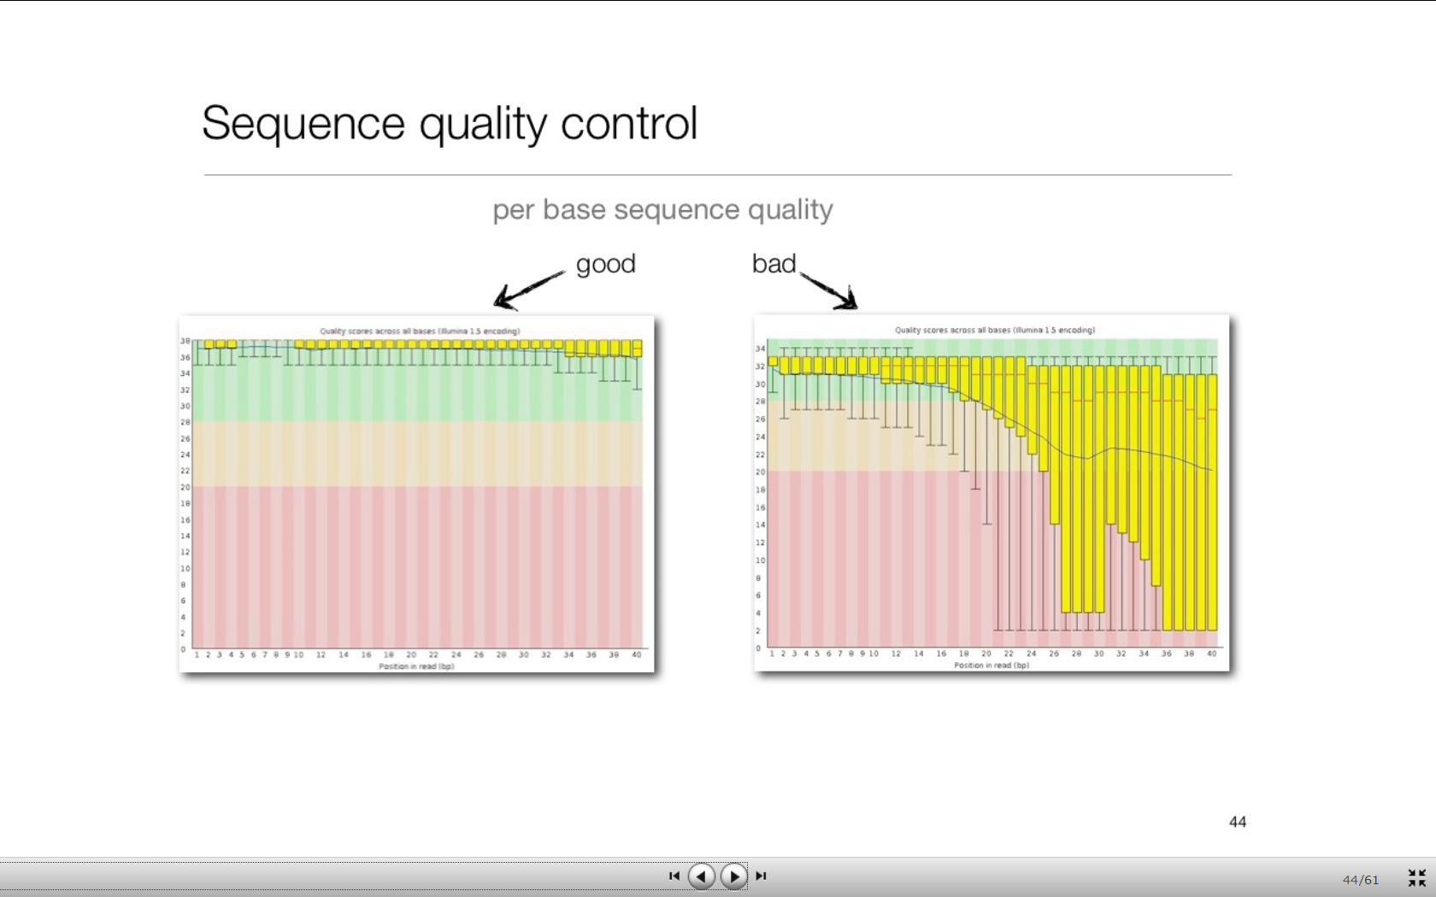
QC Raw Reads
Per Base Quality Score
S1: ATCGCTGACTAGCTCCCCTCGAGCTCTTAGCTCTAGC
S2: GATCTAGCGGATCTCTCCCCGAGCTCTTTTTCGAGCT
S3: TCTTAAGCGCTATACGCGGAGTACTCGCGATATTCGG
S4: TTTTTCGAGGCGCTATCAGGCTTATCGGCTATCTAGC
S5: TCTATTGCGATTCTCTTTTCAGGAACTATGACTCTAC
Represents the distribution of quality scores across all reads at each position on the read.
The distribution is represented as a boxplot.
Background color indicates high quality values as green, good quality as pink and low quality as red

Slide 20
QC Raw Reads on RNA-Seq
Per Base Quality Score
Depending on the experiment, low quality values at the end of the reads may be acceptable. In example for SNP calling low Q values are unacceptable. For RNA Seq they will be acceptable as long as they do not reduce the abitlity to map the read to the features.

Slide 21
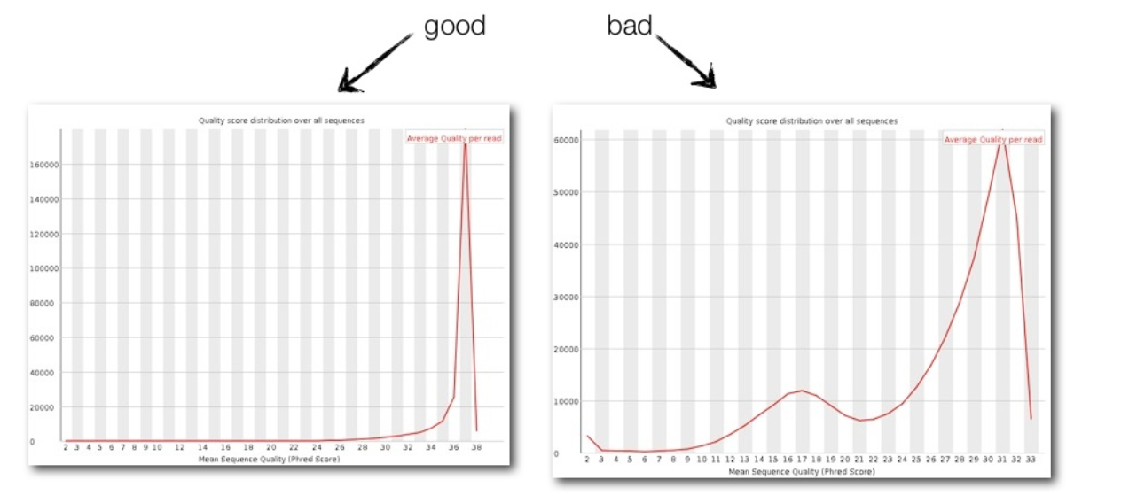
QC Raw Reads on RNA-Seq
Per Sequence Mean Quality Score
S1: ATCGCTGACTAGCTCCCCTCGAGCTCTTAGCTCTAGC
S2: GATCTAGCGGATCTCTCCCCGAGCTCTTTTTCGAGCT
S3: TCTTAAGCGCTATACGCGGAGTACTCGCGATATTCGG
S4: TTTTTCGAGGCGCTATCAGGCTTATCGGCTATCTAGC
S5: TCTATTGCGATTCTCTTTTCAGGAACTATGACTCTAC
32
32
37
37
37
2
3
Most of the reads have an average quality over 30
A group of reads have low quality

Slide 22
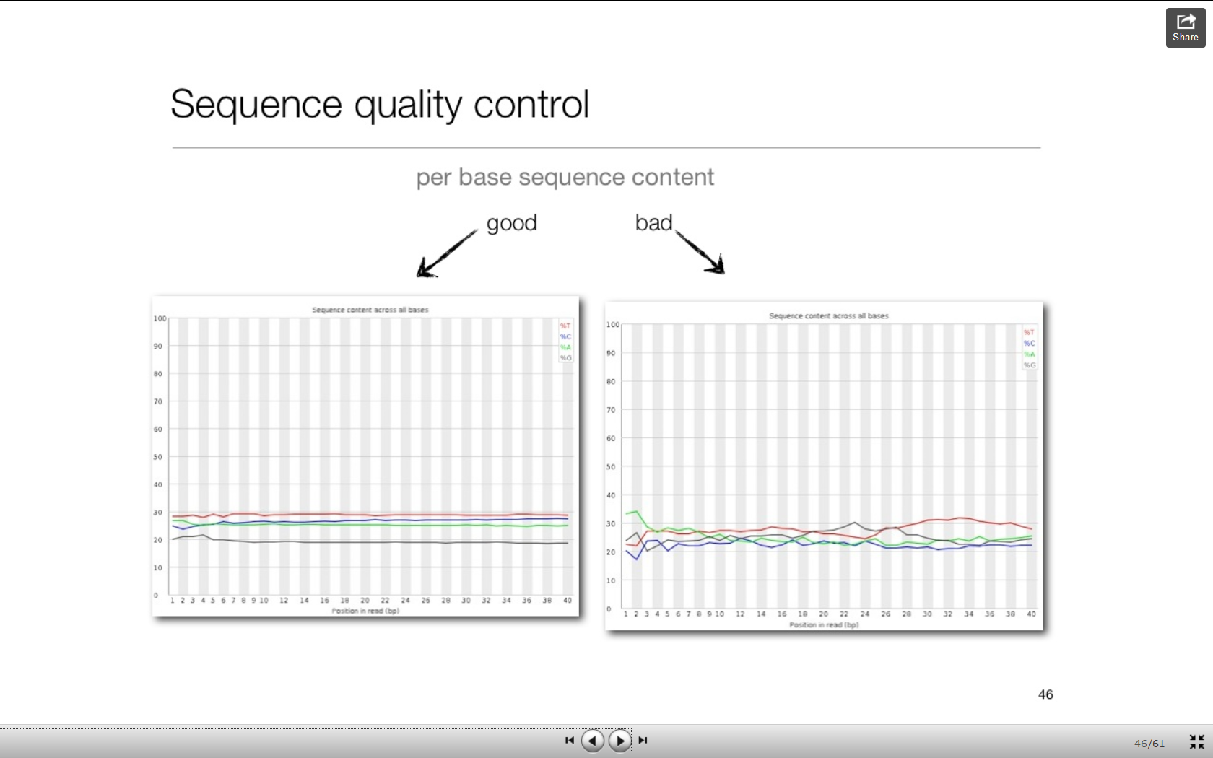
QC Raw Reads
Per Position Base Proportions
S1: ATCGCTGACTAGCTCCCCTCGAGCTCTTAGCTCTAGC
S2: GATCTAGCGGATCTCTCCCCGAGCTCTTTTTCGAGCT
S3: TCTTAAGCGCTATACGCGGAGTACTCGCGATATTCGG
S4: TTTTTCGAGGCGCTATCAGGCTTATCGGCTATCTAGC
S5: TCTATTGCGATTCTCTTTTCAGGAACTATGACTCTAC
Represents the distribution of frequencies of the four nucleotides across all reads at each position on the read.
The frequency is represented as a line plot.
Red: T, Blue: C, Green: A, Black: G

Slide 23
QC Raw Reads on RNA-Seq
Per Position Base Content
Uneven distribution of Ts across sequence length indicating low complexity or library bias
Even distribution of Ts across sequence length

Slide 24
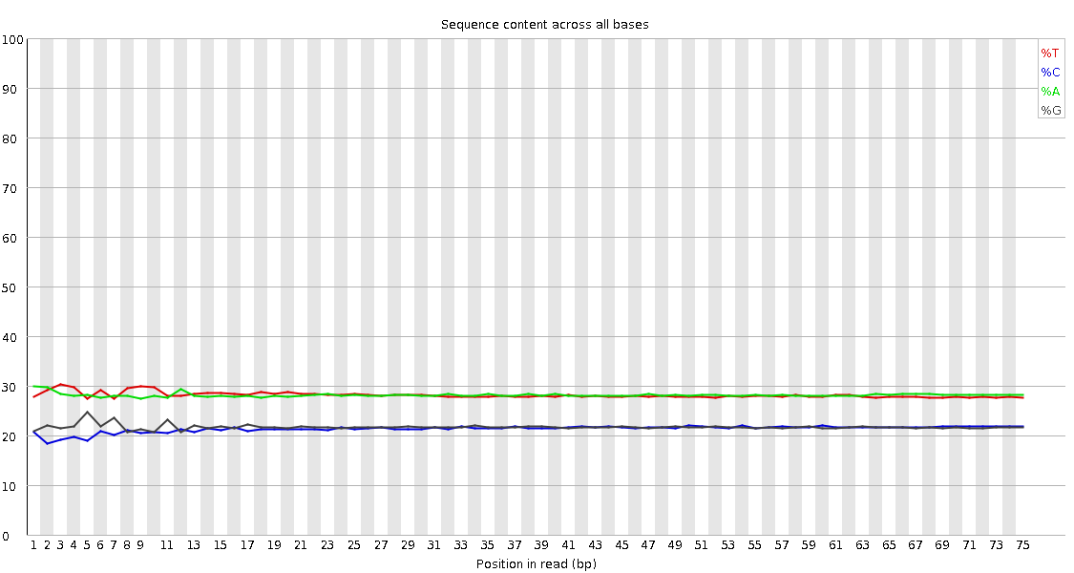
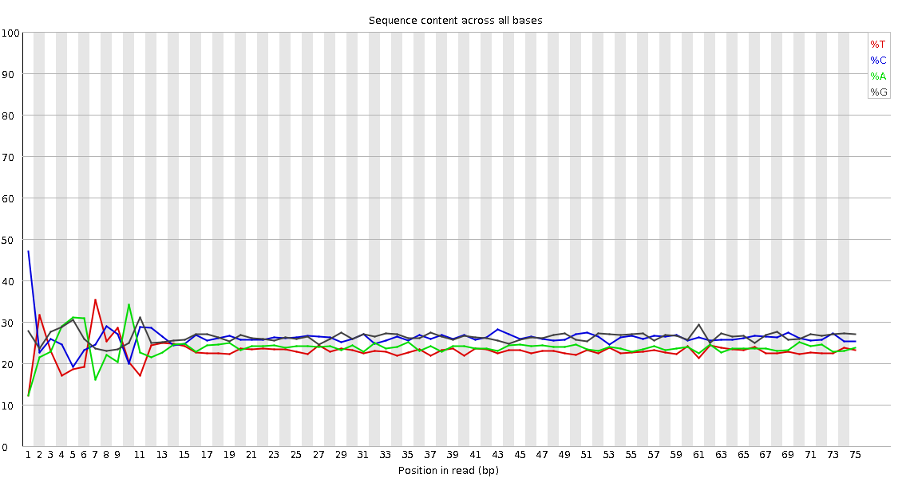
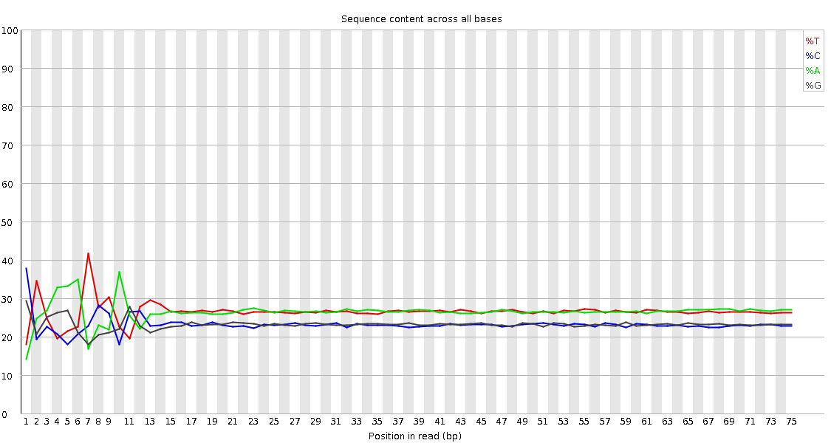
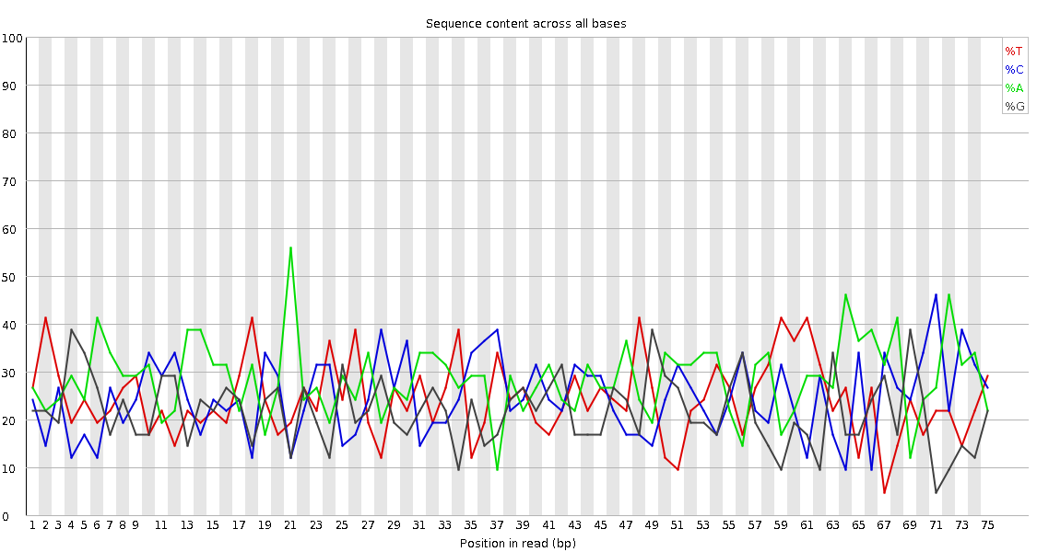
QC Raw Reads
Per Position Base Content
Normal values in different experiments
RNASeq high quality base sequence content
RNASeq low quality base sequence content
Uneven base content indicates low complexity or overrepresentation of a particular sequence, like the sequencing adaptor
Normal bias at first nucleotides due to library preparation methods
RNASeq very poor quality base sequence content
Discard it

Slide 25
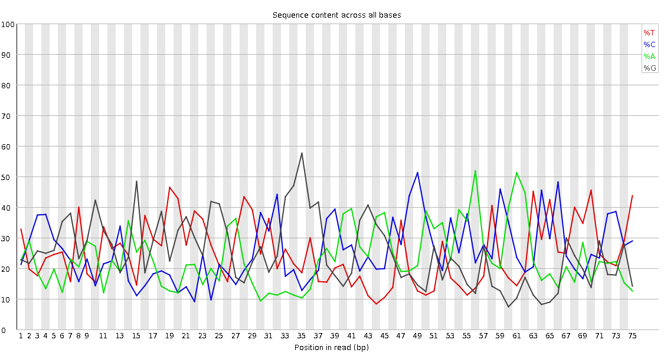
QC Raw Reads on RNA-Seq
Per Position Base Content
Normal values in different experiments
Good quality base content for a miRNA library
Given the low number of miRNAs coded by the genome and the more reduced number expressed at each tissue is expected to see low complexity profiles in miRNA libraries

Slide 26
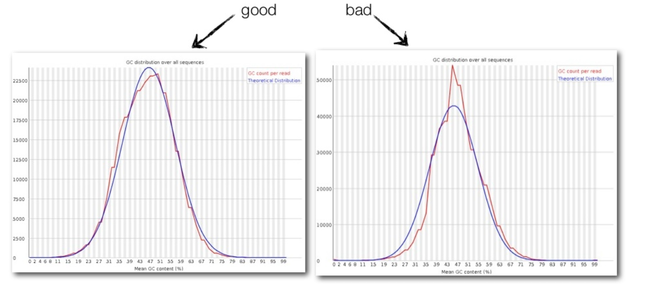
QC Raw Reads
Per Sequence GC Content
S1: ATCGCTGACTAGCTCCCCTCGAGCTCTTAGCTCTAGC
S2: GATCTAGCGGATCTCTCCCCGAGCTCTTTTTCGAGCT
47% Gs or Cs
56% Gs or Cs
Peaks at certain %GCs may indicate the presence of a particular overrepresented sequence, like sequencing adaptor or a portion of a highly expressed transcript.
Peak at a particular %GC content

Slide 27
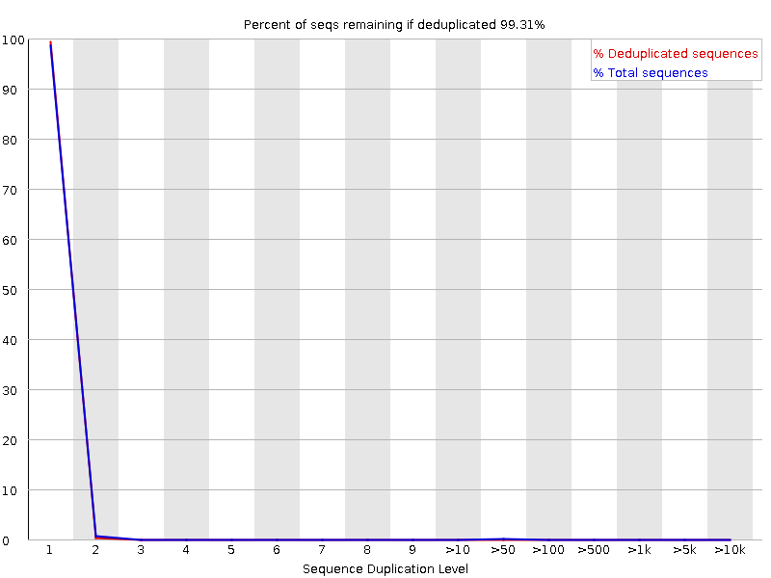
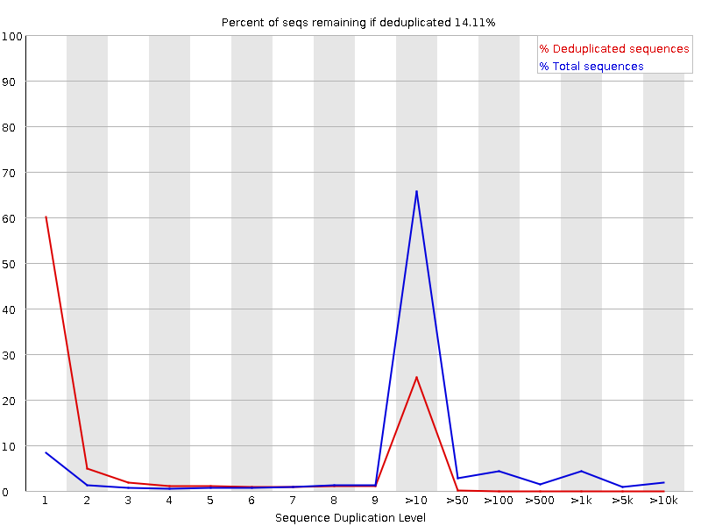
QC Raw Reads on RNA-Seq
Sequence Duplication Levels
Low duplicated library
Highly duplicated library

Slide 28
QC Raw Reads
Overrepresented Sequences:
List of sequences that are present more times than expected by chance.
The overrepresented list is annotated with the type of sequence if a list is provided to compare to.
Typically, adaptor sequences may be found overrepresented if there are high levels of primer dimer ligations in the library prep step. Often due to an unbalance between levels of adaptors and levels of sample fragments.
Some RNA-Seq from particular tissues may give also overrepresented sequences. For example blood samples contain high amounts of Haemoglobin transcripts which always is reported as overrepresented reads.
miRNA samples allways report overrepresented sequences.
Total RNA libraries report overrepresented sequences from ribosomal RNAs.

Slide 29
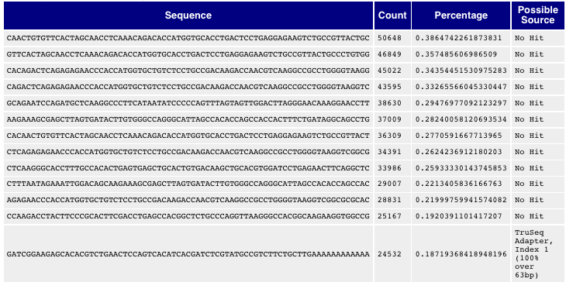
QC Raw Reads
Overrepresented Sequences:
List of overrepresented sequences from a blood sample.
The twelve first reads are coming from Haemoglobin transcripts.
The last record is the Illumina True Seq adaptor.

Slide 30
NGS Analysis WorkFlow
Initial QC
Pre-processing and Post-QC
Feature Reference
Alignment
Detection
Counting
Farther Statistical Analysis

Slide 31
Preprocessing Reads
Goals:
Improve quality
Improve mapability
Remove contaminants
Remove biases
Remove non-informative segments

Slide 32
Preprocessing Reads
Processing steps of fastq reads depends on the type of experiment and QCs obtained on raw data
Questions to have in mind when deciding which processing steps apply to the reads
How is the experiment design?
Which are the DNA/RNA features I want to interrogate?
How were this features enriched in our samples?
Which kind of library has been done?
There are many tools in the community developed to this end.
Most common tools used:
fastx_trimmer
fastq_quality_trimmer
fastx_clipper
Cutadapt

Slide 33
Preprocessing Reads
What to do when quality of base calls is low
Considerations:
Base quality can affect variant calling analysis and if severe, also mapping to features.
Base quality usually drops at the end of the read and sometimes at the beginning.
Also, low quality sequencing may produce group of reads that are low quality along it’s length.
It is essential to remove low quality bases for Variant Calling analysis.
For other analysis only remove it if it affects mapping performance.
Actions to improve analysis:
Trim those segments of the reads with low quality.
Discard reads with low mean quality value.
Possible tools:
fastq_quality_trimmer
Cutadapt
…

Slide 34
Preprocessing Reads
What to do when Adaptors are overrepresented
Considerations:
When adaptors are overrrepresented means the fragment size of the library is small on average.
For miRNAs that’s normal as we are enriching in sequences of 22nts but for RNASeq of DNASeq is not ideal.
The presence of adaptor in the sequence will avoid the alignment of the read as no sequence in the reference will have adaptor.
It is essential to remove the adaptor sequences to increase mappability.
Actions to improve analysis:
Trim those segments with adaptor sequence.
Discard reads smaller than 30nts except in the case of small-RNASeq.
Possible tools:
clip
Cutadapt or TrimGalore
fastx_clipper

Slide 35
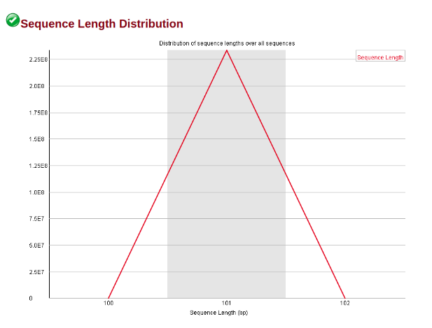
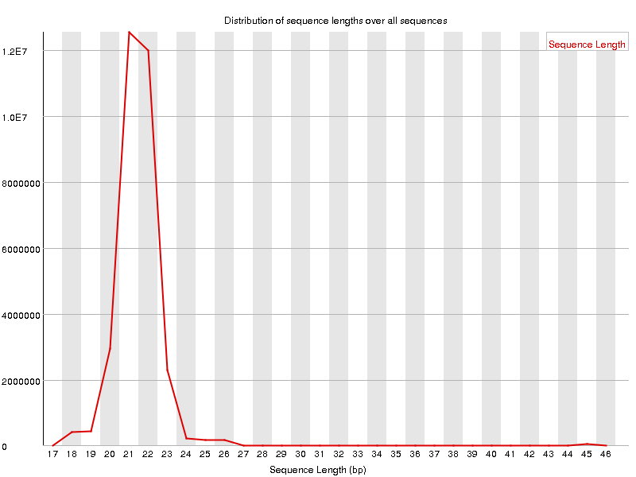
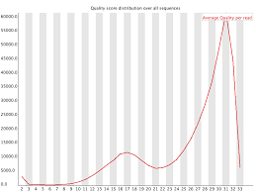
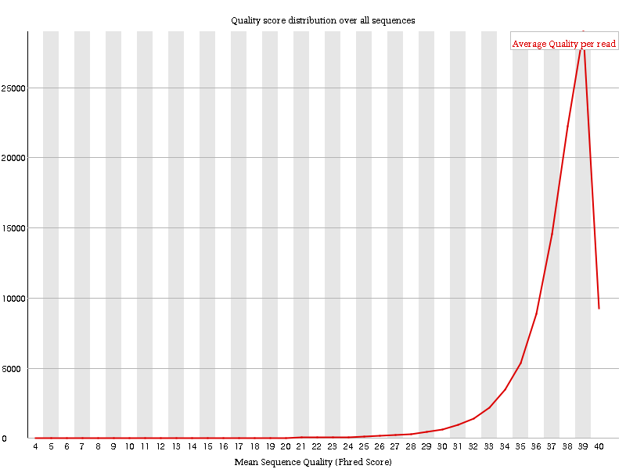
QC Raw Reads on RNA-Seq
Sequence Length
Before Processing
Good Quality miRNASeq library
Medium quality
Good Quality RNASeq library

Slide 36
NGS Analysis WorkFlow
Initial QC
Pre-processing and Post-QC
Feature Reference
Alignment
Detection
Counting
Farther Statistical Analysis

Slide 37
Data formats

Slide 38
Mapping vs alignment
Alignment:
for each locus to which a sequence can be mapped, determine the optimal base by base alignment of the query sequence to the reference sequence
Mapping:
(quickly) find the best possible loci to which a sequence could be aligned

Slide 39
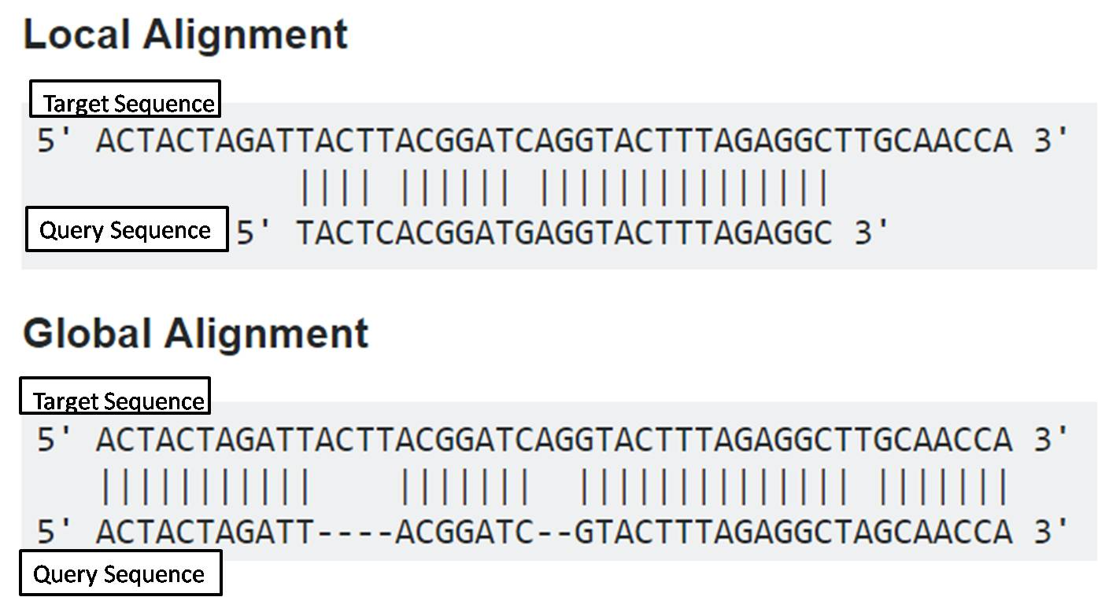
Traditional aligners

Slide 40
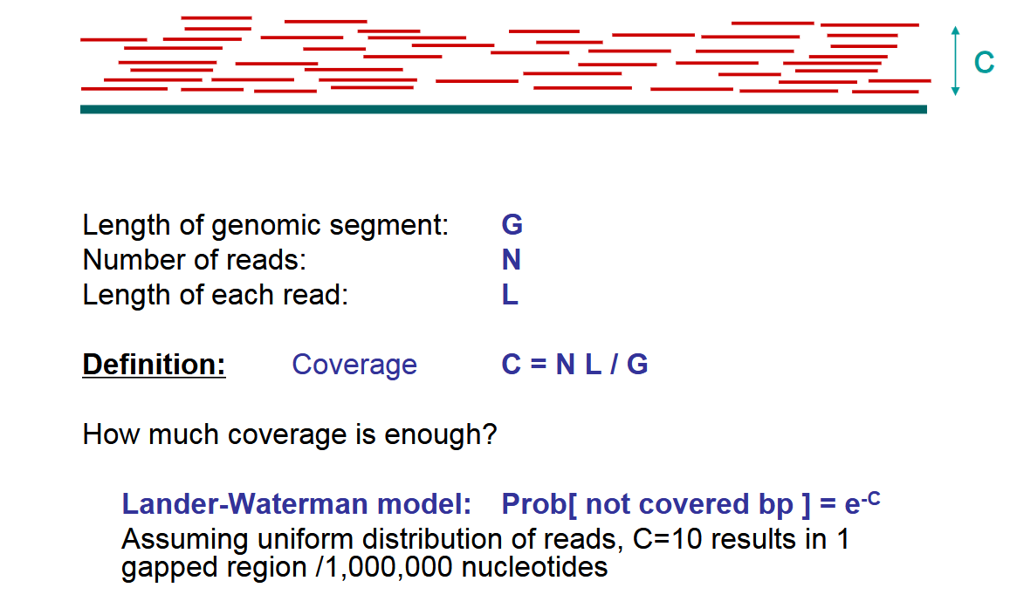
Coverage

Slide 41
MappinG Reads
Requirements for aligners:
A reference in fasta format
Reads in fastq/fasta
An indexed reference
Goals:
Map reads to features by alignment
Identify unambiguously which feature produced it.
Work efficiently

Slide 42
MappinG Reads
The Indexed Reference:
The indexed reference allows the new aligners to map efficient and accurately millions of reads.
BWA and Bowtie aligners use the Borrows Wheeler Transformation method or versions of it to index and compress the reference.
All aligners provide tools to index the reference specifically for the aligner from a FASTA file.

Slide 43
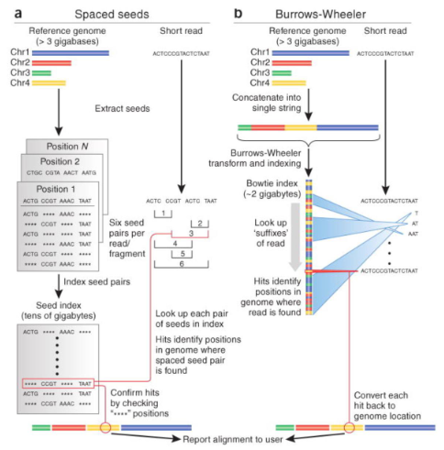
Mapping/Alignment Algorithms for NGS
Indexing
Organize genome information to be more accessible for algorithms
One time per genome
Hash tables
Space seeds based: Maq
Needlman-Wunsch: Novoalign
Burrows-Wheeler transformation based
Bowtie2
BWA
http://web.stanford.edu/class/cs262/presentations/lecture4.pdf
Notes:
BW Transformation
En este caso lo que se hace es juntar todos los cromosomas del genoma de referencia en una única secuencia y construir todas las posibles subsecuencias. Las ordenan y le aplican la transformación de Burrows-Wheeler para comprimirla.
El proceso de alineamiento comienza por un extremo de la secuencia (como si fuese diccionario) hasta localizar la posición exacta.
Ej: empieza a buscar la T en el índice y se queda con aquellas subsecuecias que empiezan por T, luego amplia la búsqueda al siguiente nucleótido y así hasta que encuentra la posición exacta.
Este algoritmo es el utilizado en los alineadores desarrollados en los últimos años. Es más rápido que el anterior, aunque tiene el inconveniente de que tolera menos el mismatch y los INDELs.

Slide 44
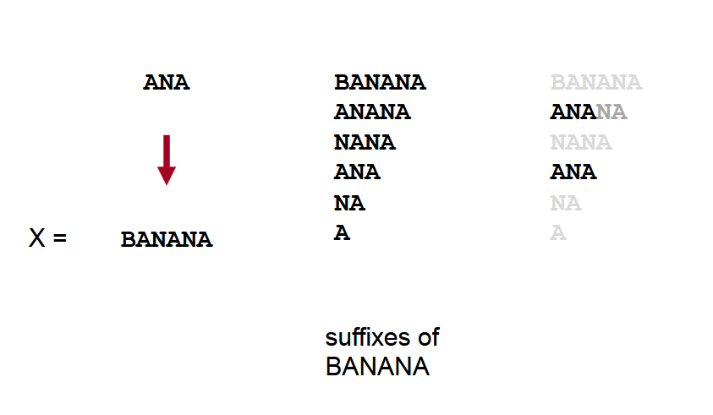
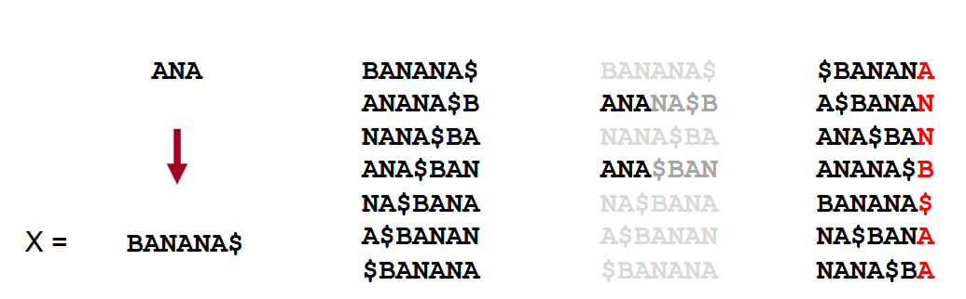
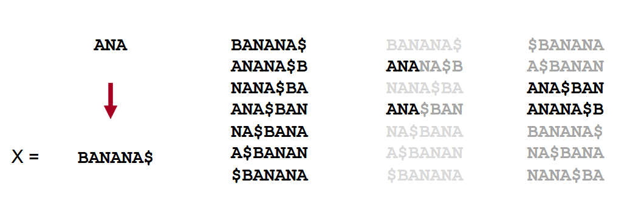
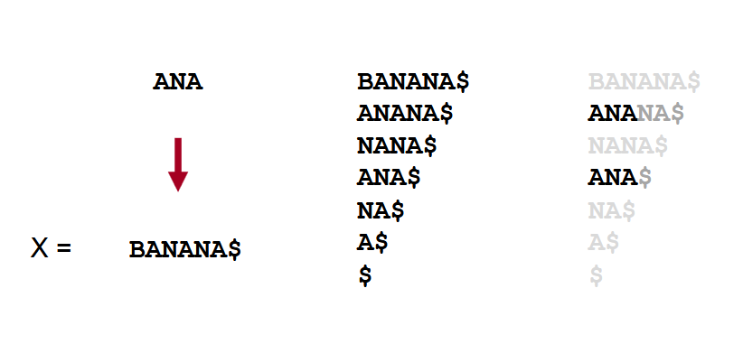
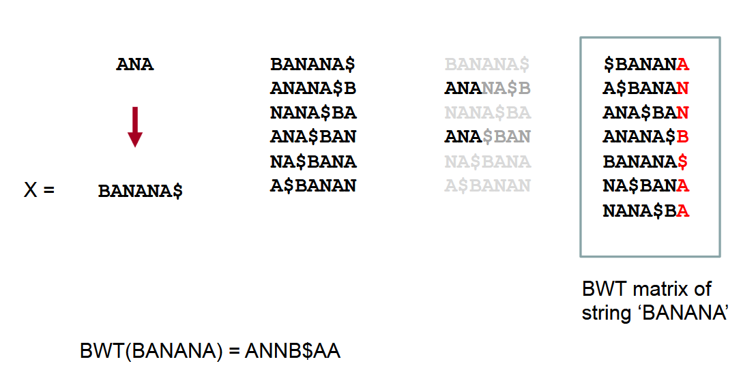
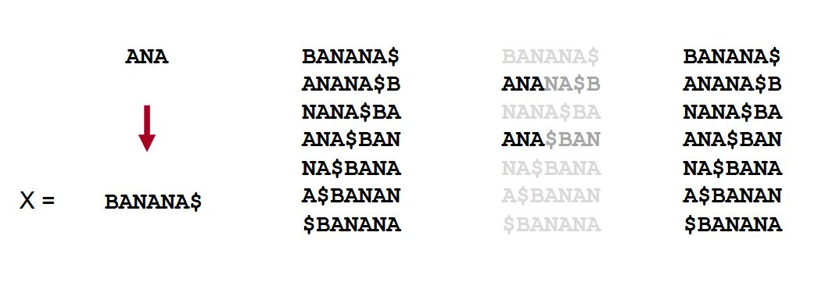
bwa
SORT ALPHABETICALLY
ROTACIONES

Slide 45
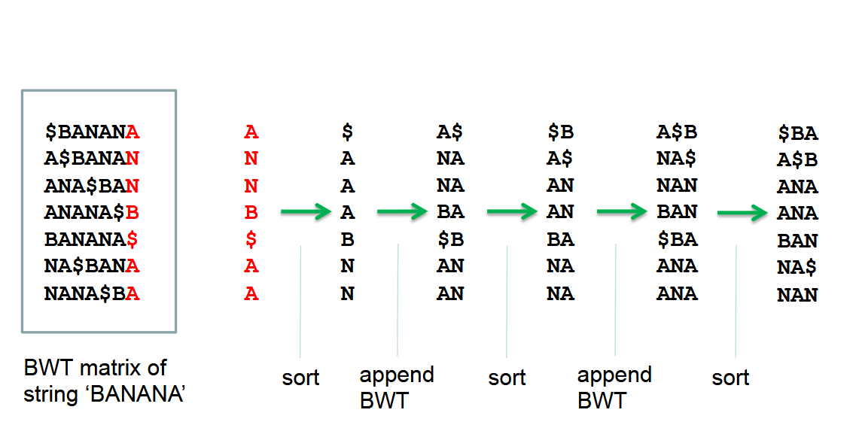

Slide 46
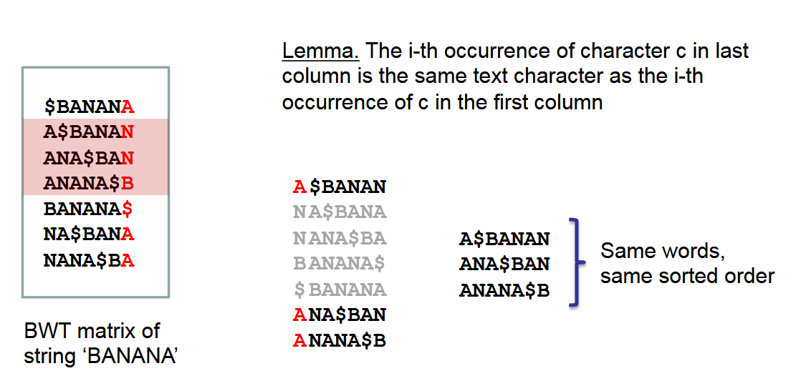

Slide 47
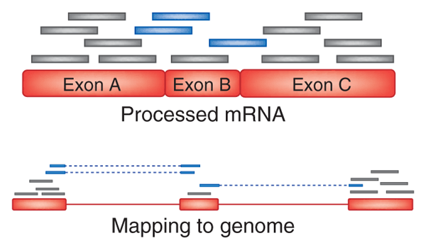
MappinG Reads: The RNA-Seq Alignment problem

Slide 48
MappinG Reads: The RNA-Seq Alignment problem
Alignment against TRANSCRIPTOME (RSEM,BWA,Bowtie):
The reference is a list of ~100K transcripts of average length around 2-3kb.
Problems:
Transcriptome is not always available
Transcript variance is not fully known even for humans.

Slide 49
MappinG Reads: The RNA-Seq Alignment problem
Alignment against GENOME and TRANSCRIPTOME:
The reference is the genome. 24 chromosomes of ~100Mb each on average.
Transcriptome can be used if available.
Try to infer transcript structure from alignments
Problems:
Assembly of transcriptome from reads is very complex due to the use of shared exons.
Detection of small exons is difficult.

Slide 50
MappinG Reads
Main tools for Deep Sequecing Read Aligments:
For DNA
BWA/BWA-MEM (http://bio-bwa.sourceforge.net/)
Bowtie/Bowtie2 (http://bowtie-bio.sourceforge.net/bowtie2/)
For RNA
HISAT2(based on Bowtie2)
RSEM (based on Bowtie1, 2 or STAR)
STAR
KALISTO
SALMON

Slide 51
MAPPING REPORT
A read can may be mapped to 0, 1 or more locations.
Unmapped
Uniquely mapped
Multi mapped reads
When several locations are found, they can be subdivided in primary (best scoring) and secondary (lower and still good scores) alignment
We can choose to report
All alignments
All best alignments
Random alignment of the best ones
All above a threshold

Slide 52
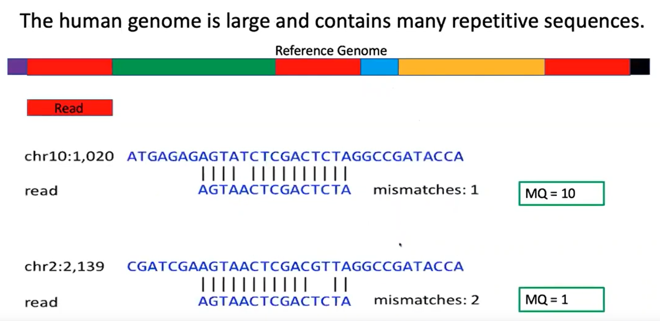
Mapping redundancies
Mapping Quality
MQ=0 if the read maps with the same probability to several places in the genome ->
the aligner assigns the read to one of them randomly

Slide 53
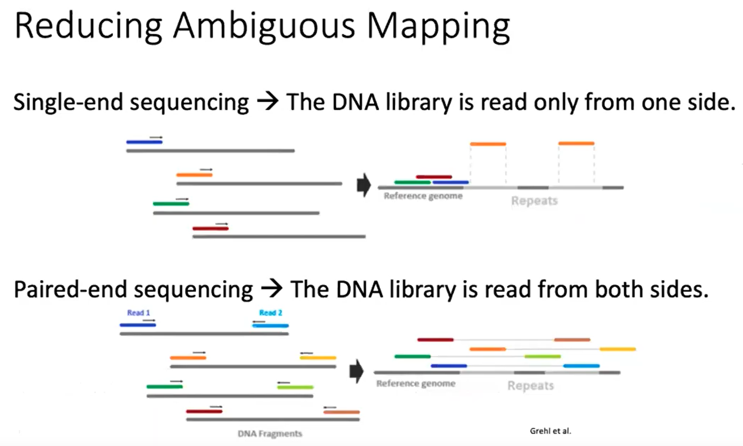

Slide 54
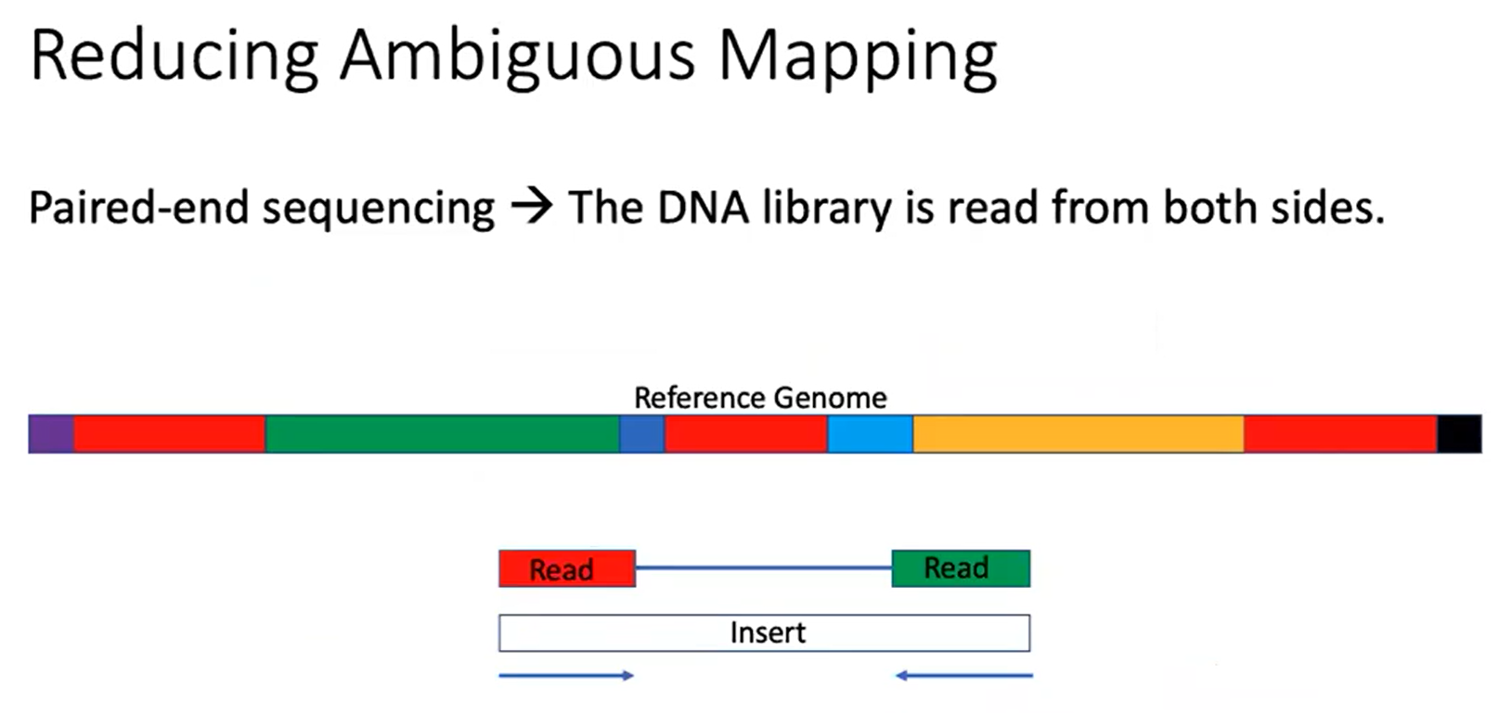

Slide 55
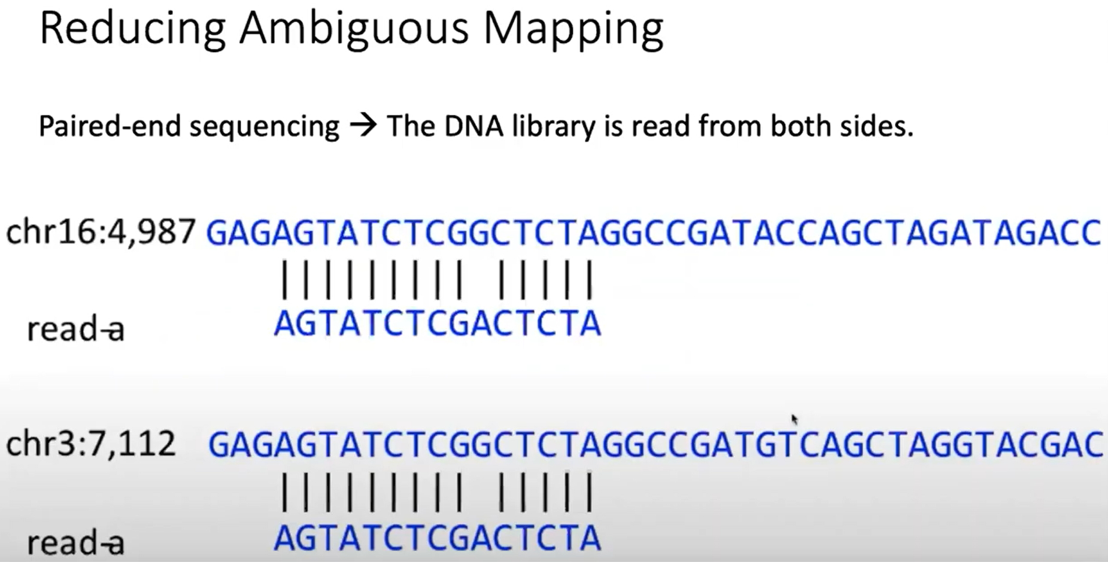

Slide 56
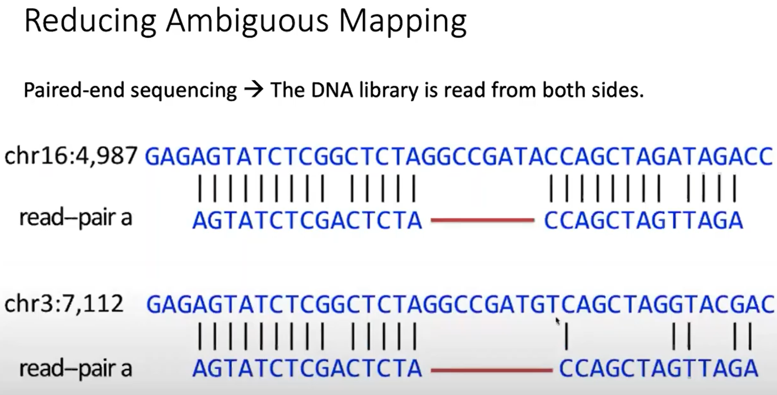

Slide 57
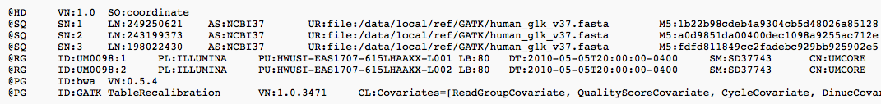
SAM/BAM Format
Format designed to store information about alignments of NGS sequencing data
The file starts with a header followed by alignment records.
Header
Provides information about the reference and the tool used to map the reads
http://samtools.github.io/hts-specs/SAMv1.pdf

Slide 58
SAM/BAM Format
Alignment Record
QNAME FLAG RNAME POS MAPQ CIGAR MRNM MPOS LEN SEQ
1:497:R:-272+13M17D24M 113 1 497 37 37M 15 100338662 0 CGGGTCTGACCTGAGGAGAACTGTGCTCCGCCTTCAG 0;==-==9;>>>>>=>>>>>>>>>>>=>>>>>>>>>> XT:A:U NM:i:0 SM:i:37 AM:i:0 X0:i:1 X1:i:0 XM:i:0 XO:i:0 XG:i:0 MD:Z:37
19:20389:F:275+18M2D19M 99 1 17644 0 37M = 17919 314 TATGACTGCTAATAATACCTACACATGTTAGAACCAT >>>>>>>>>>>>>>>>>>>><<>>><<>>4::>>:<9 RG:Z:UM0098:1 XT:A:R NM:i:0 SM:i:0 AM:i:0 X0:i:4 X1:i:0 XM:i:0 XO:i:0 XG:i:0 MD:Z:37
19:20389:F:275+18M2D19M 147 1 17919 0 18M2D19M = 17644 -314 GTAGTACCAACTGTAAGTCCTTATCTTCATACTTTGT ;44999;499<8<8<<<8<<><<<<><7<;<<<>><< XT:A:R NM:i:2 SM:i:0 AM:i:0 X0:i:4 X1:i:0 XM:i:0 XO:i:1 XG:i:2 MD:Z:18^CA19
9:21597+10M2I25M:R:-209 83 1 21678 0 8M2I27M = 21469 -244 CACCACATCACATATACCAAGCCTGGCTGTGTCTTCT <;9<<5><<<<><<<>><<><>><9>><>>>9>>><> XT:A:R NM:i:2 SM:i:0 AM:i:0 X0:i:5 X1:i:0 XM:i:0 XO:i:1 XG:i:2 MD:Z:35
Columns:
QNAME: Query template/pair NAME
FLAG: bitwise FLAG
RNAME: Reference sequence NAME
POS: 1-based leftmost POSition/coordinate of clipped sequence
MAPQ: MAPping Quality (Phred-scaled)
CIGAR: extended CIGAR string
MRNM: Mate Reference sequence NaMe (‘=’ if same as RNAME)
MPOS: 1-based Mate POSistion
LEN: inferred Template LENgth (insert size)
SEQ: query SEQuence on the same strand as the reference
QUAL: query QUALity (ASCII-33 gives the Phred base quality)
OPT: variable OPTional fields in the format TAG:VTYPE:VALUE

Slide 59
SAM/BAM Format
FLAG Column
If you think of a standard integer as being composed of 32 bits (0 or 1) then it would look like
…
1
1
1
1
1
1
1
1
1
1
1
1
Template having multiple segments
Each segment properly aligned
Segment unmapped
Next segment in the template unmapped
SEQ being reverse complement
SEQ of next segment in template being reverse complement
The first segment in template
The last segment in template
Secondary alignment
Not passing quality control
PCR or optical duplicate
Supplementary alignment

Slide 60
SAM/BAM Format
FLAG Column
Converting to a number Information
Bit 0 - false - add nothing Single End Bit 1 - true - add 2**1 = 2 Properly Aligned Bit 2 - false - add nothing Is Mapped Bit 3 - true - add 2**3 = 8 NA Bit 4 - true - add 2**4 = 16 Reverse strand Bit pattern = 11010 = 16+8+2 = 26 So the flag value would be 26.
https://broadinstitute.github.io/picard/explain-flags.html

Slide 61
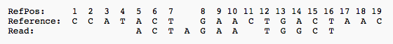
SAM/BAM Format
CIGAR Line Column
The CIGAR Line explains how is the alignment between segment and template
POS: 5
CIGAR: 3M1I3M1D5M
M alignment match (can be a sequence match or mismatch)
I insertion to the reference
D deletion from the reference
N skipped region from the reference
S soft clipping (clipped sequences present in SEQ)
H hard clipping (clipped sequences NOT present in SEQ)
P padding (silent deletion from padded reference)
= sequence match
X sequence mismatch

Slide 62
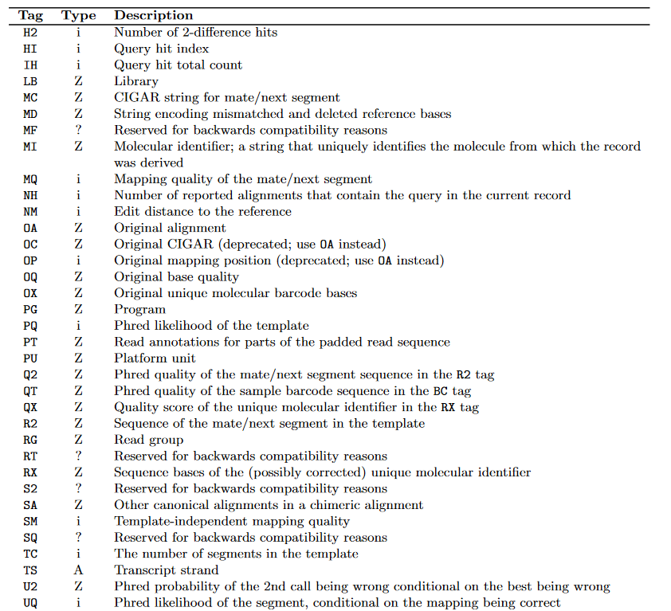
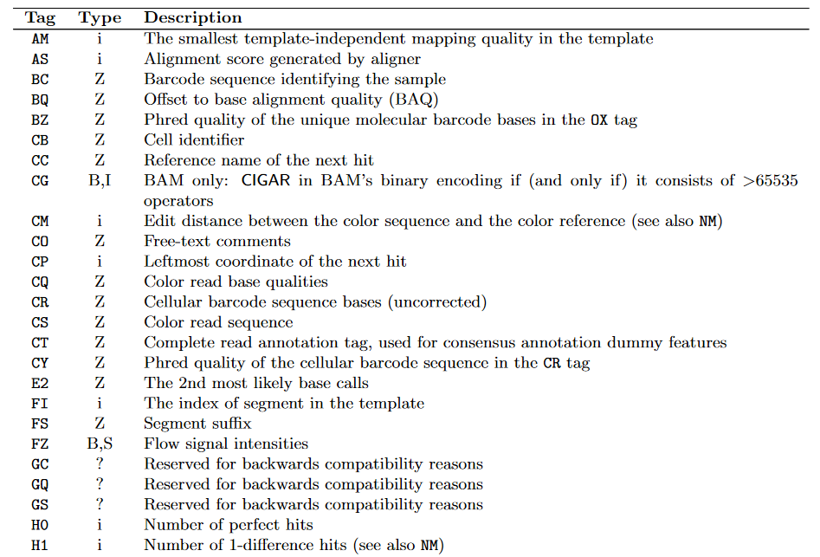
SAM/BAM Format
TAGs Columns
https://samtools.github.io/hts-specs/SAMtags.pdf

Slide 63
NGS Analysis WorkFlow
Initial QC
Pre-processing and Post-QC
Feature Reference
Alignment
Detection
Counting
Farther Statistical Analysis

Slide 64
Detection by enrichment
GOAL: Identify new unknown features
HOW?:
Each type of feature requires a specific algorithm to detect it.
The algorithm may depend on the protocol used to extract your sample
All algorithms are based on:
Analysis of the level of enrichment of the feature
Analysis of the compatibility of the region identified with the typical characteristics of the feature we want to detect: Is it compatible with a miRNA or mRNA or TF binding site structure?

Slide 65
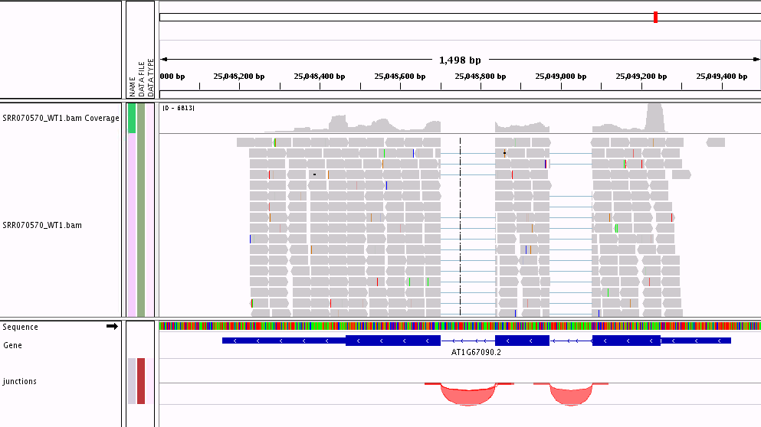
Detection by enrichment
RNA-Seq
Tools: TopHat2 + Cufflinks, …

Slide 66
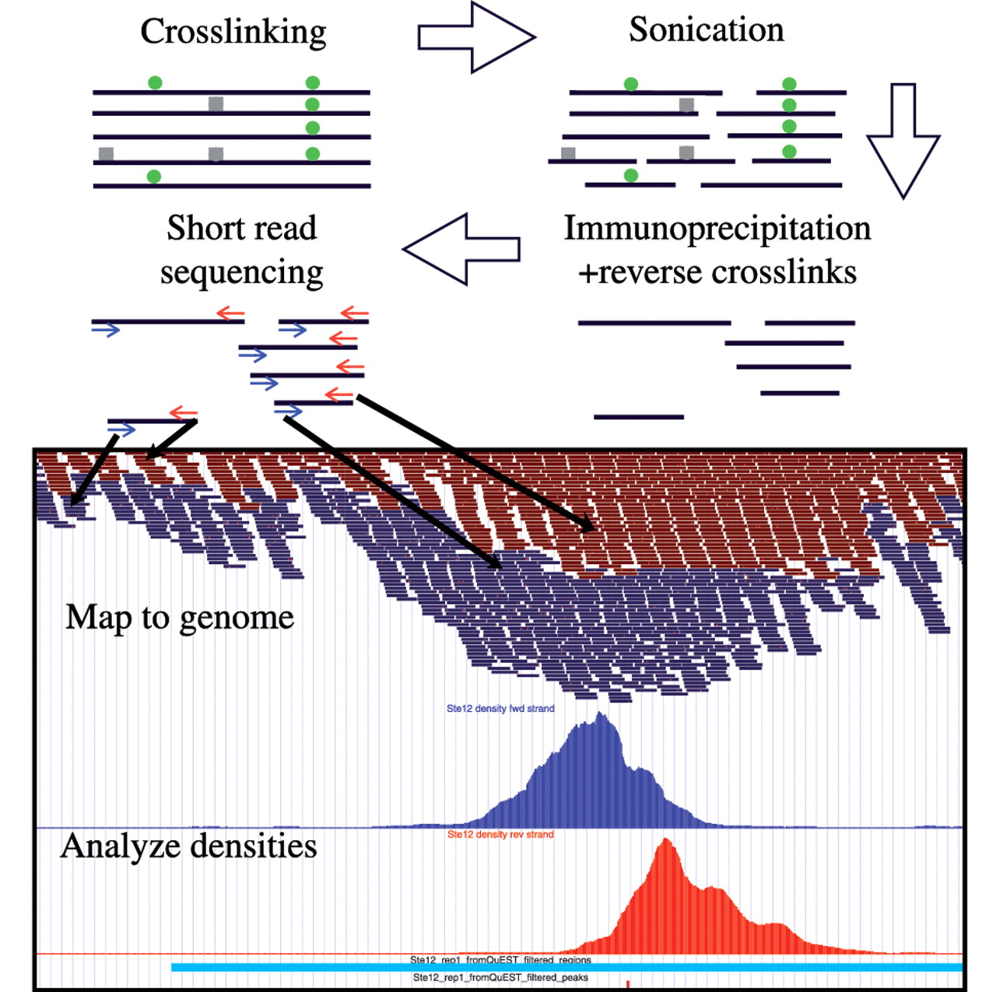
Detection by enrichment
Chip-Seq
Tools: MACS, PICS, …

Slide 67
Data formats

Slide 68
Information FORMATS
BED: For annotation of genome features
GTF: For annotation of genes
GFF3: For annotation of genes
VCF: For annotation of variants
Wig: For annotation of running scores
….

Slide 69
BED/BigBed(bb) Analysis Features
track name=pairedReads description="Clone Paired Reads" useScore=1
chr22 1000 5000 cloneA 960 + 1000 5000 0 2 567,488, 0,3512
chr22 2000 6000 cloneB 900 - 2000 6000 0 2 433,399, 0,3601
SeqID
blockSizes
Start
End
Score
thickStart
RGB
thickEnd
blockCount
blockStarts
Feature Name
Strand

Slide 70
Wig/BigWig or BedGraph Running Scores
variableStep chrom=chr2
300701 12.5
300702 12.5
300703 12.5
300704 12.5
300705 12.5
fixedStep chrom=chr3 start=400601 step=100
11
22
33
variableStep chrom=chr2 span=5
300701 12.5
Wig
chr19 49302000 49302300 -1.0
chr19 49302300 49302600 -0.75
chr19 49302600 49302900 -0.50
chr19 49302900 49303200 -0.25
chr19 49303200 49303500 0.0
chr19 49303500 49303800 0.25
chr19 49303800 49304100 0.50
chr19 49304100 49304400 0.75
chr19 49304400 49304700 1.00
BedGraph

Slide 71
NGS Analysis WorkFlow
Initial QC
Pre-processing and Post-QC
Feature Reference
Alignment
Detection
Counting
Farther Statistical Analysis

Slide 72
Count occurrences
GOAL: How much feature do I have in my sample?
HOW?
Count how many fragments do I obtain from that feature
In singe-end sequencing a fragment is defined by one read.
In paired-end sequencing a fragment is defined by two reads.
Fragment should be compatible with the feature

Slide 73
Data formats

Slide 74
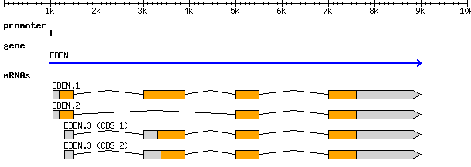
GTF/Tabix Gene Features
chr1 mm9_ensGene start_codon 134212807 134212809 0.000000 + . gene_id "ENSMUSG00000009772"; transcript_id "ENSMUST00000072177";
chr1 mm9_ensGene CDS 134212807 134213049 0.000000 + 0 gene_id "ENSMUSG00000009772"; transcript_id "ENSMUST00000072177";
chr1 mm9_ensGene exon 134212703 134213049 0.000000 + . gene_id "ENSMUSG00000009772"; transcript_id "ENSMUST00000072177";
chr1 mm9_ensGene CDS 134221530 134221650 0.000000 + 0 gene_id "ENSMUSG00000009772"; transcript_id "ENSMUST00000072177";
chr1 mm9_ensGene exon 134221530 134221650 0.000000 + . gene_id "ENSMUSG00000009772"; transcript_id "ENSMUST00000072177";
chr1 mm9_ensGene CDS 134222783 134222806 0.000000 + 2 gene_id "ENSMUSG00000009772"; transcript_id "ENSMUST00000072177";
chr1 mm9_ensGene exon 134222783 134222806 0.000000 + . gene_id "ENSMUSG00000009772"; transcript_id "ENSMUST00000072177";
chr1 mm9_ensGene CDS 134224274 134224425 0.000000 + 2 gene_id "ENSMUSG00000009772"; transcript_id "ENSMUST00000072177";
chr1 mm9_ensGene exon 134224274 134224425 0.000000 + . gene_id "ENSMUSG00000009772"; transcript_id "ENSMUST00000072177";
chr1 mm9_ensGene CDS 134224708 134224773 0.000000 + 0 gene_id "ENSMUSG00000009772"; transcript_id "ENSMUST00000072177";
chr1 mm9_ensGene exon 134224708 134224773 0.000000 + . gene_id "ENSMUSG00000009772"; transcript_id "ENSMUST00000072177";
chr1 mm9_ensGene CDS 134226535 134226654 0.000000 + 0 gene_id "ENSMUSG00000009772"; transcript_id "ENSMUST00000072177";
chr1 mm9_ensGene exon 134226535 134226654 0.000000 + . gene_id "ENSMUSG00000009772"; transcript_id "ENSMUST00000072177";
chr1 mm9_ensGene CDS 134227136 134227268 0.000000 + 0 gene_id "ENSMUSG00000009772"; transcript_id "ENSMUST00000072177";
chr1 mm9_ensGene exon 134227136 134227268 0.000000 + . gene_id "ENSMUSG00000009772"; transcript_id "ENSMUST00000072177";
chr1 mm9_ensGene CDS 134227898 134228955 0.000000 + 2 gene_id "ENSMUSG00000009772"; transcript_id "ENSMUST00000072177";
chr1 mm9_ensGene stop_codon 134228956 134228958 0.000000 + . gene_id "ENSMUSG00000009772"; transcript_id "ENSMUST00000072177";
Type
End
Strand
SeqID
Attributes
Start
Score
Source
Phase

Slide 75
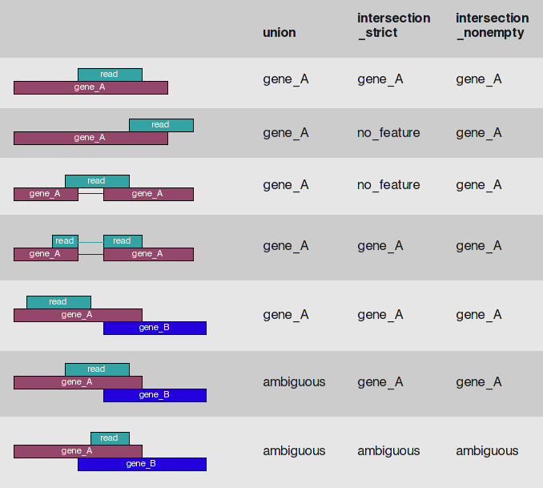
Count occurrences
Htseq count method
Tools: HTSeq, RSEM, Cufflinks,…

Slide 76
Mapping Reads: The RNA-SEQ alignment problem

Slide 77

Alignment against TRANSCRIPTOME:
The reference is a list of ~100.000 transcripts of average length around 2-3kb.
Problems:
Transcriptome is not always available
Transcript variance is not fully known even for humans
Multimapping reads

Slide 78
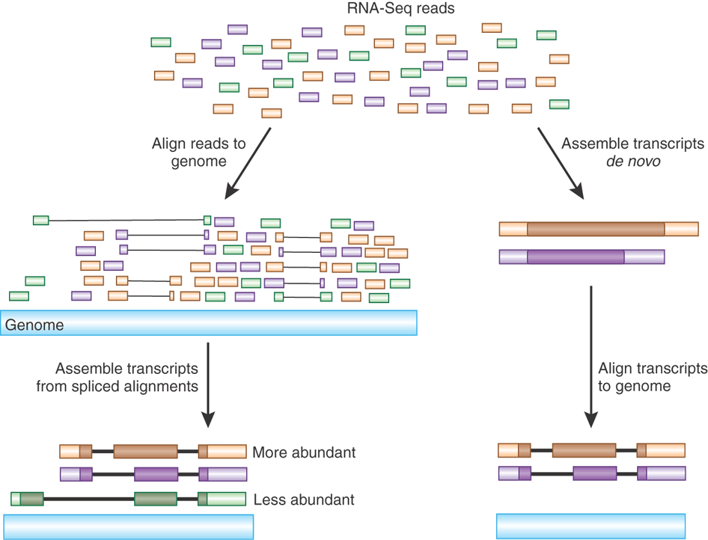
Gene expression quantification from RNA-Seq
.fastq
Reference Genome/Transcriptome (gtf file)
Isoform A
Isoform B
Isoform C
Gene
1. Align reads to reference (Bowtie)
2. Quantify
3. Generate estimators
3a. For absolute gene/isoform
quantification
3b. For gene/isoform
Differential expression
.bam
.tsv/csv
CA = 20
CB = 16
Cc = 12
CG = 48

Slide 79
Gene expression quantification from RNA-Seq
Reference Genome/Transcriptome (gtf file)
.fastq
Isoform A
Isoform B
Isoform C
Gene
1. Align reads to reference (Bowtie)
2. Quantify
3. Generate estimators
3a. For absolute gene/isoform
quantification
3b. For gene/isoform
Differential expression
.bam
.tsv/csv
CA = 20
CB = 16
Cc = 12
CG = 48

Slide 80

Need to normalize by length and library size

Slide 81

Quantification metrics from raw reads: RPKMs

Slide 82

Quantification metrics from raw reads: tpms

Slide 83
Multimapping reads?
Reference Genome/Transcriptome (gtf file)
.fastq
Isoform A
Isoform B
Isoform C
Gene
1. Align reads to reference (Bowtie)
2. Quantify
3. Generate estimators
3a. For absolute gene/isoform
quantification
3b. For gene/isoform
Differential expression
.bam
.tsv/csv
CA = 20
CB = 16
Cc = 12
CG = 48

Slide 84



RSEM/SALMON/SAILFISH to deal with multimapping reads
We have the data (N reads of length L): R₁,…R_{N}
We want to infer the expression of each isoform
[θ₀… θ_{M}] assuming the data structure:
Complete Data Likelihood:
Observed Likelihood:
Iteratively estimate [θ₀… θ_{M}]
maximizing the likelihood
For each read, there is a certain probability to belong to each isoform, what depends on
the isoform expression level (θ), read alignment(s) start position (S) and orientation (O)

Slide 85

RSEM output

Slide 86

RSEM to deal with multimapping reads
According to Reference
Part of the gene really expressed
CI
Fragments per Kb
per Million mapped Reads
Transcripts per million
(x 10⁶)
Counts and TPM: Comparison analysis
FPKMs: Absolute quantification

Slide 87

RSEM to deal with multimapping reads
% of expression of this isoform over the whole gene exp

Slide 88


RSEM to deal with multimapping reads
SMN1
SMN2

Slide 89
NGS Analysis WorkFlow
Initial QC
Pre-processing and Post-QC
Feature Reference
Alignment
Detection
Counting
Statistical Analysis

Slide 90
Evaluate differences
Gene Expression: Estimate significance of fold changes between conditions.
Chip-Seq: Estimate significance of fold enrichments above a background or negative control.

Slide 91
Evaluate differences
Tools to evaluate differences in RNASeq:
edgeR
DESeq2
Cuffdiff
Sleuth
EBSeq
Issues they solve:
Overestimation of Dispersion due to low “n”
Not in the range of Central Limit to consider Normal Distribution.
Correct for Multiple testing

Slide 92
Analysis pipeline for differential gene/transcript expression using RNA-Seq
Alignment
RSEM (alignment using Bowtie2)
SAILFISH/SALMON (Quasi-mapping)
HTseq (no multi-mapping handling)
Gene and Transcript
Quantification
Filtering and normalization
edgeR/deseq/limma
Statistical Analysis

